Slide 1
Lecture 23:
6.2. Trade and Development; Foreign Aid; Foreign Intervention
Brad DeLong
Department of Economics & Blum Center, U.C. Berkeley; & WCEG
last revised: Su 2020-04-12
for presentation: Th 2020-04-23
Original course by Melissa Dell (Harvard Econ 1342), revised by Brad DeLong
<https://github.com/braddelong/public-files/blob/master/econ-135-lecture-23.pptx>
< https://www.icloud.com/keynote/0_hQOtKpPzq3oGpMEhZTACkJQ>

Slide 2
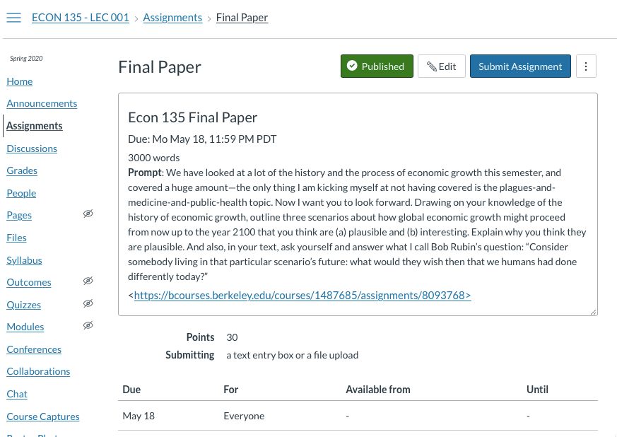
Final Paper

Slide 3
Discussion
Trade and Development; Foreign Aid; Foreign Interventions:
What strikes you as important here?

Slide 4
Trade and Development; Foreign Aid; Foreign Intervention
Th Apr 23: 6.2. Trade and Development; Foreign Aid; Foreign Intervention:
Slides: <https://github.com/braddelong/public-files/blob/master/econ-135-lecture-23.pptx>

Slide 5

Trade & Development
We have had 500 years of globalization:
Many of the poorest places in the world are those that are not integrated into regional, national, and international trade
Trade allows specialization, which typically improves static economic efficiency
Dynamic efficiency is another kettle of fish
Globalization creates winners and losers
Initial circumstances determine the impacts of economic integration on institutions and growth
Initial circumstances determine who wins versus loses from globalization
Trade integration solidifies an economy’s niche in the global economy
Governments have incentives to try to extract as large a share of the surplus from globalization as possible
10:30 minutes of audio for this segment; 33:00 minutes of audio for this lecture as a whole
2:30
Notes:
Nevertheless, an enormous amount of wealth was created by the process of globalization. Because of globalization, the world as a whole shared in the upward leap of wealth that was the Commercial Revolution of 1500-1770—recall our guesses that the pace of growth h of the value of the human stock of useful economic ideas about technology and organization surged from 0.035%/year to 0.15%/year as the world crossed 1500, with the invention of the caravel. And, while the world did not share equally in the subsequent jump as it crossed 1770, the industrial revolution began, and h jumped to 0.69%/year, it did share. And some—perhaps a tenth?—of that further acceleration was due to globalization. And the same could be said of the further jump to 2.1%/year as the world crossed 1870 and MEG began. This time globalization accounted for perhaps 1/3 of the jump.
And then began the dance of global comparative advantage. How was the surplus from globalization in the context of modern economic growth to be divided. Who was going to gain the most from the process of global comparative advantage?
Countries have an incentive to implement policies that will concentrate their comparative advantage in a leading sector.
A few countries—South Korea or Taiwan—appear to have been successful at this. Many other times, these policies failed spectacularly.
Development economists in the 1940s and 50s challenged the conventional wisdom that globalization had been beneficial for developing countries. Classical economists had argued that trade integration should—if anything—benefit developing countries in the long-run, because the supply of land is inelastic. But, empirically, this seemed not to be obviously so. And so economists started to question this conventional wisdom in the aftermath of the Great Depression.
Charlie Kindleberger (1943): The terms of trade of agriculture decline over the long run due to Engel’s law, and so responding to today’s global market price signals by specializing in agriculture traps an economy in a dead end. Raul Prebisch (1950) focused on monopoly power in the global north as the source of the twist of the terms of trade of agricultural-exporting poor and developing countries against them. In his view the causes were organized labor and industrial monopoliy capiital in the global north. Hans Singer (1950) noted the process of de-industrialization in developing countries that exposed themselvs to the world market.
W. Arthur Lewis began arguing in (1954) that surplus labor leads the gains from technological progress in agriculture to accrue to consumers in the developed world—we saw this argument before, when we read his book on the evolution of the international economic order.
Baran (1957) and Furtado (1959) focused their attention on the internal colonization of the global south by its elites—most of the returns from trade accrue to large landowners or foreign investors and are spent abroad
But the policies of import-substitution industrialization that the Prebisches and Singers recommended were no more successful in inducing global south catchup in the post-WWII world.
There is hope that we are finally seeing a less unequal distribution of the fruits of globalization. But at the moment that is still much more of a hope than a confident certainty. Yes, the global south has begun to catch up in the past two decades. Yes, even Africa is now growing rapidly. But more than half of the catchup has been the result of inept policies and slow growth in the global north since 2000.
Trade has not been nearly the engine of development that economists like Adam Smith and his successors had confidently expected.

Slide 6
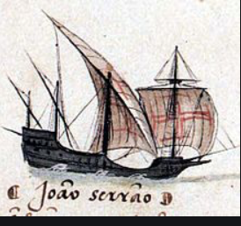
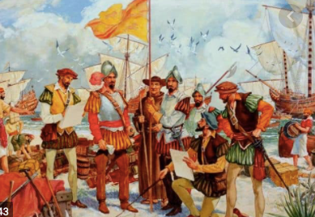
A Very Short History of Early Globalization
It really starts in the 1500s with the caravel:
The West Indies—we have covered the shock of the conquistadores and their cannon, smallpox, and steel breastplates
The East Indies:
Cutting out the middleman
Making the products of India, China, and southeast Asia much cheaper
This wave of globalization had big winners and big losers:
In wealth, the winners gained much more than the losers gained
In human utility, the losers lost much more than the winners gained
Possible role of globalization in triggering the Industrial Revolution, and then MEG…
1:00
Notes:
Let me remind you of the very short history of early globalization.
It really starts in the 1500s with the caravel: the first ship type that could reliably and semi-safely make it across the world’s oceans.
The caravel led to the “integration” of the West Indies—the Americas—into a Europe-centered economic world. We have covered the shock of the conquistadores and their cannon, smallpox, and steel breastplates. The caravel led to much cheaper shipment of goods between Europe and the the East Indies—cutting out the middlemen, and making the products of India, China, and southeast Asia much cheaper to European consumers.
This wave of globalization had big winners and big losers: In wealth, the winners gained much more than the losers lost.
In human utility, the losers lost much more than the winners gained. And there is the possible role of this globalization in triggering the Industrial Revolution, and then MEG…

Slide 7
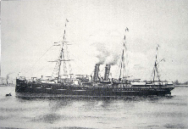
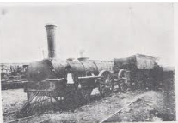
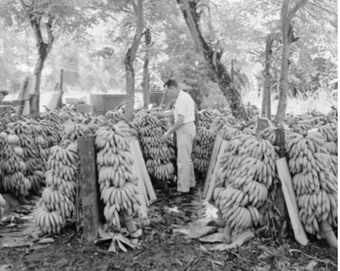
First Modern Globalization
1815-1914:
Railroads, steamship, and telegraphs made possible:
Mass transport of goods
Mass transport of information
Mass transport of people—a greater share of the world’s population changed continents between 1845-1914 than at any time before or since, by far
Connection to world markets not perceived as an unmixed good: Melissa Dell’s anecdote from Peru:
The steamship made it feasible for Peruvian wool producers to sell to Britain.
Peasants knew an increase in wool prices would lead to land grabs. Attempted to stop the construction of a railroad from wool producing areas to the coast.
Many of the gains from trade seem to have been absorbed by quelling persistent peasant unrest (Jacobsen, 1993)
United Fruit Company & co. (Dube, Kaplan, and Naidu (2011):
Eisenhower was easily grifted by corporations. So were other presidents:
The authorization of the overthrow of the Arbenz regime in Guatemala
U.S. and Belgian operations to neutralize the Lumumba government in the Congo after it refused to allow copper-rich Katanga to secede
Salvador Allende’s acceleration of the nationalization of Chile’s copper industry
2:00
Notes:
The first truly modern globalization—the first one in which the process could be said to have touched nearly everything about an economy—came over 1850-1914. Railroads, steamships, and telegraphs made possible the mass transport of goods, the mass transport of information, and the mass transport of people—a greater share of the world’s population changed continents between 1845-1914 than at any time before or since, by far.
The connection to world markets was not perceived as an unmixed good: Melissa Dell tells an anecdote from nineteenth-century Peru: The steamship made it feasible for Peruvian wool producers to sell to Britain. Peasants knew an increase in wool prices would lead to land grabs. Attempts to stop the construction of a railroad from wool producing areas to the coast. They failed: the railroad was built. Yet then many of the gains from trade seem to have been absorbed by quelling persistent peasant unrest (Jacobsen, 1993)
And then there was the United Fruit Company & co. (Dube, Kaplan, and Naidu (2011). Eisenhower was easily grifted by corporations. So were other presidents: Eisenhower authorized the overthrow of the Arbenz regime in Guatemala. He thought Arbenz was a communist. Actually, Arbenz simply wanted the United Fruit Company to work for the people of Guatemala, rather than primarily for its shareholders, secondarily for U.S. consumers, and for the people of Guatemala not at all. Later, at the start of the 1960s, the U.S. and Belgium would work together to “neutralize” the Lumumba government in the Congo. The Lumumba government wanted to tax the copper-rich province of Katanga. Belgian mining interests wanted the province to secede, so that it would pay no taxes to the central government of the Congo—in fact, so that mining interests could try to keep control of the Katanga government and pay no taxes to anybody at all. Richard Nixon sought the overthrow of Salvador Allende’s government in Argentina, primarily because of its acceleration of the pace of nationalization of Chile’s copper industry.

Slide 8
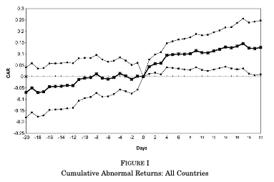
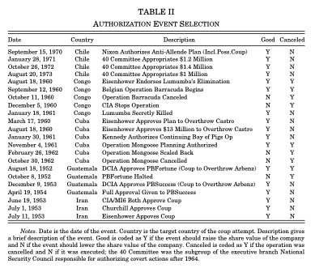
Profit!
Coup authorization leaked out into the financial markets:
22 “events”
Some people profited very handsomely
Focus on a four day return starting at the event date.
Control for four Fama-French factors
excess return on the NYSE (market)
SMB (small)
HML (value)
MOM (momentum)
Results: over 4 days after the decision date, a 10% excess return on equity positions…
1:00
Notes:
Dube, Kaplan, and Naidu back in 2011 looked at how porous the CIA and the executive branch of the U.S. government wree. Suppose the president authorized the CIA to try to conduct a coup. What happened to the stock prices of companies that stood to benefit from the installation of a right-wing, multinational busincess-friendly government in the days after the president signed the authorization? It turns out the prices of their stocks went up by 10% in the four days after the president affixed his signature. If you think that, by the time a PDD had gotten to the president’s desk, that the policy was already 90% baked into the cake—that there was only a 10% chance that the president would refuse to approve the recommendation of his bureaucracy—then the affected business interests stood to double their wealth from U.S. intervention. And a large chunk of that doubling went into the pockets of those with friends among the White House staff who violated classified information secrecy laws and told their friends that now was a good time to do some illegal insider trading.

Slide 9
Today
Global comparative advantage:
Countries have an incentive to implement policies that will concentrate their comparative advantage in a leading sector
A few countries—South Korea or Taiwan—appear to have been successful at this.
Many other times, these policies failed spectacularly
Development economists in the 1940s and 50s challenged the conventional wisdom that globalization had been beneficial for developing countries
Classical economists argued that trade integration should—if anything—benefit developing countries in the long-run because the supply of land is inelastic
Economists started to question this conventional wisdom in the aftermath of the Great Depression:
Kindleberger (1943): The terms of trade of agriculture decline over the long run due to Engel’s law.
Prebisch (1950): The terms of trade of agriculture decline; emphasized organized labor and industrial monopolies in developed countries as mechanisms.
Singer (1950): Agricultural terms of trade in decline. De-industrialization in developing countries.
Lewis (1954): Surplus labor leads the gains from technological progress in agriculture to accrue to consumers in the developed world.
Baran (1957); Furtado (1959): Most of the returns from trade accrue to large landowners or foreign investors and are spent abroad
But ISI was no more successful in the post-WWII world
4:00
Notes:
Nevertheless, an enormous amount of wealth was created by the process of globalization. Because of globalization, the world as a whole shared in the upward leap of wealth that was the Commercial Revolution of 1500-1770—recall our guesses that the pace of growth h of the value of the human stock of useful economic ideas about technology and organization surged from 0.035%/year to 0.15%/year as the world crossed 1500, with the invention of the caravel. And, while the world did not share equally in the subsequent jump as it crossed 1770, the industrial revolution began, and h jumped to 0.69%/year, it did share. And some—perhaps a tenth?—of that further acceleration was due to globalization. And the same could be said of the further jump to 2.1%/year as the world crossed 1870 and MEG began. This time globalization accounted for perhaps 1/3 of the jump.
And then began the dance of global comparative advantage. How was the surplus from globalization in the context of modern economic growth to be divided. Who was going to gain the most from the process of global comparative advantage?
Countries have an incentive to implement policies that will concentrate their comparative advantage in a leading sector.
A few countries—South Korea or Taiwan—appear to have been successful at this. Many other times, these policies failed spectacularly.
Development economists in the 1940s and 50s challenged the conventional wisdom that globalization had been beneficial for developing countries. Classical economists had argued that trade integration should—if anything—benefit developing countries in the long-run, because the supply of land is inelastic. But, empirically, this seemed not to be obviously so. And so economists started to question this conventional wisdom in the aftermath of the Great Depression.
Charlie Kindleberger (1943): The terms of trade of agriculture decline over the long run due to Engel’s law, and so responding to today’s global market price signals by specializing in agriculture traps an economy in a dead end. Raul Prebisch (1950) focused on monopoly power in the global north as the source of the twist of the terms of trade of agricultural-exporting poor and developing countries against them. In his view the causes were organized labor and industrial monopoliy capiital in the global north. Hans Singer (1950) noted the process of de-industrialization in developing countries that exposed themselvs to the world market.
W. Arthur Lewis began arguing in (1954) that surplus labor leads the gains from technological progress in agriculture to accrue to consumers in the developed world—we saw this argument before, when we read his book on the evolution of the international economic order.
Baran (1957) and Furtado (1959) focused their attention on the internal colonization of the global south by its elites—most of the returns from trade accrue to large landowners or foreign investors and are spent abroad
But the policies of import-substitution industrialization that the Prebisches and Singers recommended were no more successful in inducing global south catchup in the post-WWII world.
There is hope that we are finally seeing a less unequal distribution of the fruits of globalization. But at the moment that is still much more of a hope than a confident certainty. Yes, the global south has begun to catch up in the past two decades. Yes, even Africa is now growing rapidly. But more than half of the catchup has been the result of inept policies and slow growth in the global north since 2000.
Trade has not been nearly the engine of development that economists like Adam Smith and his successors had confidently expected.

Slide 10
Foreign Aid
The history of post-WWII foreign aid:
The heyday of foreign aid was in the 1950s
The Marshall Plan is the most famous instance, but large amounts of foreign aid also went to economies that would soon become the East Asian Tigers
Various qualitative accounts claim that the aid to these developing countries was highly successful, but to my knowledge no one has had an empirical strategy to test this hypothesis
A major motivation of this aid was to prevent the spread of Communism
The Sachs-Easterly Debate
Sachs: Aid does incredible good, and we just be serious about giving more of it
Easterly: Most aid is siphoned off by corrupt governments and naive aid agency employees
Easterly: Most never reaches its intended recipient
Easterly: Aid focuses governments and entrepreneurs on pleasing foreign governments & NGOs, and diverts them from taking steps to raise productivity
5:15 minutes of audio
2:15
Notes:
There have long been arguments about how effective do-gooder government and NGO foreign aid programs are. The heyday of foreign aid programs was in the 1950s: the idea was the governments and NGOs could provide the kinds of engineering assistance and support that private companies expanding into new territories had provided, and so greatly accelerate economic growth in poor countries. This would do good. This would also help the democratic north Atlantic west in its long bitter twilight cold war struggle with the Soviet Union and really existing socialism.
The major case for the success of foreign aid is the narrative of the success of the post-World War II Marshall Plan in assisting in the rebuilding of Western Europe, and in triggering its subsequent prosperity. But there were equal amounts of aid in terms of shares of national income sent to Japan and the four Asian tigers, both as a byproduct of fighting the Korean War and as explicit attempts to demonstrate that capitalism would make you richer and happier than Maoist communism. Truth be told, however, it was the institutions built, the mixed-economy pattern of economic activity created, and access to the United States’s market as importer of last resort that plausibly played a much bigger role than direct, concrete, on the ground effects of the aid.
The most recent round of the debate over foreign aid has been between Jeffrey Sachs and Bill Easterly. Sachs’s position is that foreign aid does incredible amounts of good, and we for the world’s sake desperately need to be serious about giving much much more of it.
Easterly's position is that aid does little good, and that more good would be done by spending an equivalent amount of money simply buying extra products from poor countries. Siphoned off by corrupt governments, wasted by naïv aide agency employees, winding up far from its intended recipients, aid focuses local officials and entrepreneurs on the ground on pleasing foreign governments and NGOs. And when the aid dries up, you then have local governments and entrepreneurs that are good at pleasing the aid-givers who are no longer there, but incompetent at governing or at running companies.

Slide 11
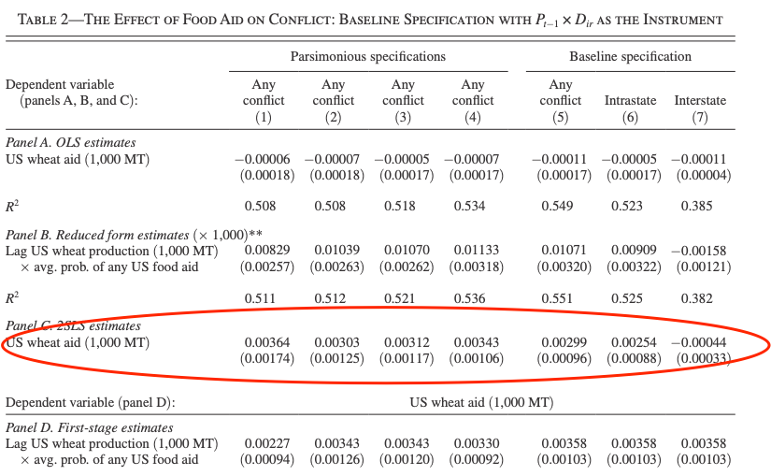
Fueling Civil Wars with Food Aid
Nathan Nunn and Nancy Qian (2014): US Food Aid and Civil Conflict:
<https://github.com/braddelong/public-files/blob/master/readings/article-nunn-qian-aid.pdf>
We study the effect of US food aid on conflict in recipient countries. Our analysis exploits time variation in food aid shipments due to changes in US wheat production and cross-sectional variation in a country’s tendency to receive any US food aid. According to our estimates, an increase in US food aid increases the incidence and duration of civil conflicts, but has no robust effect on interstate conflicts or the onset of civil conflicts. We also provide suggestive evidence that the effects are most pronounced in countries with a recent history of civil conflict…
1971-2006: UCDP/PRIO Armed Conflict Dataset (25 or more battle deaths a year)
Instrument: the interaction of last year’s US wheat production and the frequency that a country receives any US food aid
If (a) the U.S. harvest was big last year and (b) the country usually receives U.S. food aid and (c) there is an extra 1000 tons of food aid this year, then (d) the chance of a civil war starting or continuing is 25% higher…
3:00
Notes:
We are not going to resolve this argument today.
We will, however, very briefly peer into one piece of it: Nathan Nunn and Nancy Qian’s (2014) study: US Food Aid and Civil Conflict. They take advantage of the fact that the U.S. government has fairly stable preferences about which countries it should give food aid to, and that the amount of food aid the U.S. gives depends on the size of the U.S. harvest—when the harvest is big and thus agricultural prices fall, farm state senators, and there are a lot of farm state senators, focus on getting the U.S. government to buy more crops and export them to poor countries in order to boost farm gate prices and thus their constituents’ incomes.
There is no raw correlation between how much food aid the U.S. gives a country and whether a civil war in that country starts or continues. But that by itself does not tell us much. Perhaps when a civil war starts, the U.S. AID shies away from putting its people and resources at risk. Perhaps civil wars start or continue when food is scarce. Perhaps civil wars start or continue when there are valuable resources—food—that nobody in the society has clear strong title to because they just arrived from abroad and are being driven about in trucks by people working for NGOs who do not have either patron or client links in the society.
Nunn and Qian hit upon the idea of looking at a narrow slice of the variation in food aid—a slice that they believe cannot in any way be the result of the presence or absence of civil war feeding back on the amount of aid. They look at sitautions in which (a) the U.S. harvest was big last year and (b) the country usually receives U.S. food aid. Whether or not there is civil war somewhere on another continent does not affect the size of last year’s harvest. Whether or not a country is typically on the list of countries that receive U.S. food aid is only trivially caused by whether there is a civil war in that country next year. For that slice of changes in food aid—that slice correlated with the product of last year’s harvest and the propensity to give food aid to that country—Nunn and Qian find that if (c) there is an extra 1000 tons of food aid this year, then (d) the chance of a civil war starting or continuing is 25% higher.
This is a big deal. Admittedly, the civil wars are small: 25 or more battle deaths in a year. Could this be the result of the file-drawer problem—that statistics produces some false positive results, and those get published while the true negatives all wind up filed away and never publicized? Perhaps. But there is a good chance that it is real. And thus this should move your priors toward the “Easterly” side: the arrival of resources that do not have to be produced but that can be controlled by spending effort on them appears, in this case, to have unhealthy consequences for the receiving society.

Slide 12
Foreign Intervention: Army vs. Marines
Melissa Dell & Pablo Querubin (2016) on two branches of America’s armed forces with very different attitudes:
Army: overwhelming firepower (the shadow of Cold Harbor)
Marines: accomplish the mission
In Vietnam:
Army in Corps Region II: search-&-destroy
Marines in Corps Region I: embed & build
Public goods that the Marines targeted—primary education, health, and infrastructure—were substantially higher on their side of the boundary
On the Marines’ side, there were fewer VC attacks
Attitudes towards Americans and all levels of SVN government were more positive
The top-down overwhelming-firepower approach can backfire when targeted insurgents are embedded in civilian population centers
JFK (1954): “I am frankly of the belief that no amount of American military assistance in Indochina can conquer an enemy which is everywhere and at the same time nowhere...and which has the sympathy and covert support of the people…”
17:00 minutes of audio
4:45
Notes:
How about foreign interventions? I am sending the U.S. Army into Mexico, President Woodrow Wilson said in the 1910s, “to teach the Mexicans to elect good men”. General Pershing’s forces chased Pancho Villa’s forces around northern Mexico. Was the lesson that Wilson thought Pershing’s soldiers were teaching the lesson actually learned?
Melissa Dell and Pablo Querubin wrote in 2016 a paper that looked at the effects of the two different traditions of two branches of America’s armed forces: the army, and the marines. The two branches have very different attitudes.
The army—and the air force that sprang from it—believes in overwhelming firepower. Perhaps this is an institutional memory of the disastrous consequences of General Ulysses S. Grant’s frontal attack against entrenched and bloodied but unbowed rebel soldiers at Cold Harbor outside of the rebel capital of Richmond, VA. Between May 4 and May 30 Grant’s Army of the Potomac had attacked and attacked, always seeking to get around the rebel Army of Northern Virginia’s right flank and get between them and their supply bases, and always failing. By May 30 Lee’s right flank was on the nearly impassible James River. But rather than give up, Grant sent the union troops in head-on against rebels in their trenches, suffering horrendous casualties.
Ever since, the U.S. Army has jealously guarded its soldiers’ lives. The U.S. Army sends bombs, bullets, explosives, and metal at their opponents. Then it sends some more. Then it relies on the fact that American factories have been the most productive in the world to get more bombs, bullets, explosives, and metal. Extravagant and wasteful in expenditure of materiel. Frugal and prudent in the expenditure of American soldiers’ lives. That has been the U.S. Army for 155 years.
For the U.S. Marines, on the other hand, the key has been to accomplish the mission quickly. Marines’ lives are just one of the resources. Overwhelming firepower is nice to have, but it is not the first resource the Marines reach for, and they recognize that it may not even be a resource appropriate for the task. Soldiers’ lives are nice to preserve, but not at the expense of failing to accomplish the mission—or of failing to accomplish the mission in a useful way.
During the Vietnam War in the late 1960s, the U.S. Army was positioned in Corps Region II: it engaged in search-and-destroy missions, searching for Vietcong guerrillas and then destroying them—and everyone near them—with overwhelming firepower. The U.S. Marines were positioned right next door, in Corps Region I: The Marines engaged in embed-and-build: build ties with the community, spend your time gaining confidence, put soldiers to work building schools, roads, and water pumps, trying to demonstrate that peace would be better than war, that the SVN government was not an enemy that they needed to assist the Vietcong in throwing them out.
Back in 1954 then-senator and future-president John F. Kennedy had spoken against American military intervention in Vietnam:
>I am frankly of the belief that no amount of American military assistance in Indochina can conquer an enemy which is everywhere and at the same time nowhere...and which has the sympathy and covert support of the people…
The mission—to Kennedy and to the Marines—was primarily not to kill Vietcong but to win the hearts and minds of the people to the side of thinking that the government was tolerable, and that peace was better than war. The phrase “hearts and minds” comes from American Revolution patriot leader and second president of the United States John Adams, who once wrote that:
>What do we mean by the “American Revolution”? Do we mean the American war? The Revolution was effected before the war commenced. The Revolution was in the minds and hearts of the people…
This is in striking contrast to the idea—variously attributed to John Wayne, Richard Nixon, Nixon’s political aide Chuck Colson, U.S. Navy aviators on a carrier off of Vietnam, South Carolina U.S. Representative Mendel Rivers—that “when you've got them by the balls, their hearts and minds will follow…”
Dell and Querubin do indeed find that the top-down overwhelming-firepower approach can backfire when targeted insurgents are embedded in civilian population centers. In the Marine Corps region, public goods that the Marines targeted—primary education, health, and infrastructure—were substantially higher on their side of the boundary. On the Marines’ side, there were fewer VC attacks. And attitudes towards Americans and all levels of SVN government were more positive.

Slide 13
Marines Ideology
The Small Wars Manual (1940):
“In small wars the goal is to gain decisive results with the least application of force…. The end aim is the social, economic, and political development of the people subsequent to the military defeat of the enemy insurgent…”
Official History of the USMC in Vietnam:
“Marines units built schools, roads, marketplaces, and hospitals; set-up the Medical Civic Action Program (MEDCAP) to provide the rural population with regular medical care and to help develop hygienic and sanitary practices; and provided training and equipment to local and regional militia under the CAP and Combined Unit Pacification Program (CUPP) to enhance security in the rural areas…”
1:45
Notes:
This is as one would expect given the mission ideology of the U.S. Marines. As early as 1940, in their Small Wars Manual, the Marines were telling each other:
>In small wars the goal is to gain decisive results with the least application of force…. The end aim is the social, economic, and political development of the people subsequent to the military defeat of the enemy insurgent…
The people the Marines are fighting around have to believe that the Marines are fighting for them, and that the Marines’ victory is their victory. Hence as the Official History of the USMC in Vietnam states, part of the Vietnam mission for the marines was that:
>Marines units built schools, roads, marketplaces, and hospitals; set-up the Medical Civic Action Program (MEDCAP) to provide the rural population with regular medical care and to help develop hygienic and sanitary practices; and provided training and equipment to local and regional militia under the CAP and Combined Unit Pacification Program (CUPP) to enhance security in the rural areas…
Similar differences between Marine- and Army-garrisoned regions were present in the Balkans during U.S. interventions in that part of Europe in the 1990s. Indeed, I once heard former Marine Corps General John Allen state that when the Marines moved into a region in Iraq, one of their first priorities was to form women’s councils and elevate the social power and status of women: people’s aunts rarely want them to go get themselves blown up, and places where young men believe that their aunts are worth respecting are places where peace and development is more likely to be accomplished.
As for the U.S. Army ideology. Well…

Slide 14
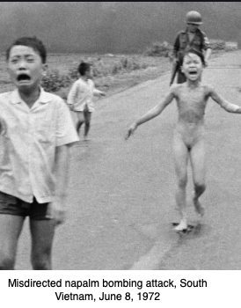
Army Ideology
Six American policymakers: The first four:
General William Westmoreland: “[Overwhelming firepower] will hamper [the VC’s] operations, reduce his forces, destroy his morale and materially detract from his ability to prosecute the war effectively…” “To thwart the communist’s designs, it is necessary to eliminate the ‘fish’ from the ‘water’, or dry up the ‘water ‘…”
General William DePuy: “The solution in Vietnam is more bombs, more shells, more napalm…”
NSA Mcgeorge Bundy: “A reprisal policy—to the extent that it demonstrates U.S. willingness to employ this new norm in counter-insurgency—will set a higher price for the future upon all adventures of guerrilla warfare, and it should therefore increase our ability to deter such adventures…” “ Even if it fails… [bombing] will be worth it. At a minimum, it will damp down the charge that we did not do all that we could have done…”
NSA Walt Whitman Rostow: “[Needed:] a ruthless projection to the peasantry that the central government intends to be the wave of the future…”
2:45
Notes:
During the Vietnam period at least, it gave effect to the preferences expressed by American policymakers. Here are four:
General William Westmoreland: “[Overwhelming firepower] will hamper [the VC’s] operations, reduce his forces, destroy his morale and materially detract from his ability to prosecute the war effectively…” “To thwart the communist’s designs, it is necessary to eliminate the ‘fish’ from the ‘water’, or dry up the ‘water ‘…” This last is a reference to a statement of Mao Zedong’s to the effect that the guerrilla needs to be a fish who can swim effortlessly through the water that is the population. In this context, to “dry up the ‘water’” might be to make the civilian population shun the guerrillas. But I do not think anyone should make a bet that that is how Westmoreland’s soldiers heard him, or that that was what he meant. I think he meant something else.
General William DePuy: “The solution in Vietnam is more bombs, more shells, more napalm…”
National Security Advisor Mcgeorge Bundy: “A reprisal policy—to the extent that it demonstrates U.S. willingness to employ this new norm in counter-insurgency—will set a higher price for the future upon all adventures of guerrilla warfare, and it should therefore increase our ability to deter such adventures…” “Even if it fails… [bombing] will be worth it. At a minimum, it will damp down the charge that we did not do all that we could have done…”
NSA Walt Whitman Rostow: “[Needed:] a ruthless projection to the peasantry that the central government intends to be the wave of the future…”
The Napalm Girl, Phan Thi Kim Phúc, despite having received third-degree burns over half her body, is alive and well and living in Toronto. Two of her young cousins did not survive the attack.
I met Walt Rostow. I liked Walt Rostow. I love his books—he was, at bottom, an economic historian and a development economist, focused on how now-rich countries became rich and what lessons we could learn and apply to make now-poor countries rich. He was chosen to be national security advisor in an age in which it was credible that an expert on economic development rather than a specialist in bombs and bullets would be a national security advisor. But, on issues of strategy and military power, he turned out to be a superhawk—not wise enough to be a John Adams.

Slide 15
Army Ideology II
Six American policymakers: Numbers five and six:
Advisor Sam Huntington: “The principal reason for this massive influx of population into the urban areas is, of course, the intensification of the war… refugees…. dramatic and often heartrending.... In the past the Viet Cong could expect to win the war simply by preventing Saigon from extending its control in the rural areas. This… is no longer sufficient to achieve victory…. The Viet Cong… have been even less successful in… [the cities] than the Government has been… in the countryside.... In an absent-minded way the United States in Viet Nam may well have stumbled upon the answer to ‘wars of national liberation’… neither… conventional military victory nor… the… gimmicks of counter-insurgency warfare. It is instead forced-draft urbanization and modernization which rapidly brings the country in question out of the phase in which a rural revolutionary movement can hope to generate sufficient strength to come to power…”
Robert McNamara: “The f***ing bombing campaign. It’s been worth nothing. It’s done nothing. They’ve dropped more bombs than in all Europe in all of World War II and it hasn’t done a f***ing thing…”
5:00
Notes:
And here are two more:
Academic, advisor, and perennial explainer of American policies Sam Huntington: “The principal reason for this massive influx of population into the urban areas is, of course, the intensification of the war… refugees…. dramatic and often heartrending.... In the past the Viet Cong could expect to win the war simply by preventing Saigon from extending its control in the rural areas. This… is no longer sufficient to achieve victory…. The Viet Cong… have been even less successful in… [the cities] than the Government has been… in the countryside.... In an absent-minded way the United States in Viet Nam may well have stumbled upon the answer to ‘wars of national liberation’… neither… conventional military victory nor… the… gimmicks of counter-insurgency…. It is instead forced-draft urbanization and modernization which rapidly brings the country in question out of the phase in which a rural revolutionary movement can hope to generate sufficient strength to come to power…”
That quote is pieced together over a number of pages: Huntington’s argument is elliptical and doubles back on itself. But if you follow the main thread, you see that he is saying that even though the increase in refugees fleeing from overwhelming firepower is “often heartrending”, the strategy of overwhelming firepower is “the answer to ‘wars of national liberation’: overwhelming firepower not only kills the fish that are the Vietcong guerrillas but dries up the water in which they swim because the mass flight of terrified refugees is the “forced-draft urbanization and modernization” needed to deprive the rural Vietcong guerrillas of their base.
And then, sixth, there is Robert McNamara, the only one I am quoting to have his head screwed on right: “The f***ing bombing campaign. It’s been worth nothing. It’s done nothing. They’ve dropped more bombs than in all Europe in all of World War II and it hasn’t done a f***ing thing…”
Now let us be clear on one thing: I am not a fan of Ho Chi Minh, or of Vo Nguyen Giap. South Vietnam would be much much happier right now—would look like Malaysia, or perhaps Taiwan—if Ho Chi Minh, Vo Nguyen Giap, and company had settled for ruling North Vietnam after 1954 and the French colonial withdrawal, and let South Vietnam develop like a normal capitalist Pacific Rim economy. The war they launched to take over South Vietnam killed 50,000 American soldiers, 1.4 million Vietnamese soldiers, and perhaps 2 million Vietnamese civilians. Their regime was cruel and brutal. And Vietnam now is only as rich as South Korea was in 1980.
But that is beside the point here. At the bar before the court of history, you cannot plea in defense of a war: "it would've been worth it if we had won!” At the bar before the court of history you have to answer the question: “Would the world be a better place if you had never fought at all?”
National Security Advisors…
I tell you, they are really strange people. I wound up in Aspen Colorado a couple of summers ago, going to an economic development conference. The next conference in was a national security conference, with various bipartisan powerbrokers and powerbroker wannabees talking about “national security”. I went to a panel on which they had four former National Security Advisors—four people who had held the job of Assistant to the President of the United States for National Security, and Chair of the National Security Council. And the moderator talked about how without a doubt it was the toughest job in the world. And all the powerbrokers and powerbroker wannabees surrounding me in the audience applauded.
And I cringed.
And I thought of a guy I know—a former captain in the U.S. Army, multiple tours of duty in Iraq, where his unit, highly skilled in mobile high intensity high firepower battle, was pressed into service as… military police… in a country where they did not speak the language. And I thought: every day he was in command in Iraq, with the lives of his soldiers who he knew well riding on his decisions, was tougher than a whole year as National Security Advisor, sitting in your air-conditioned office and calling up your favorite reporters to leak dirt about your bureaucratic adversaries in order to try to maneuver to get more influence with the president.
The bombs-and-bullets crowd—the Huntingtons, the Rostows, the Bundys, plus the Generals Westmoreland and DePuy—really strange people.

Slide 16
Sam Huntington on the Cuban-Americans of Miami
He did not like them:
“Latinos have not assimilated into mainstream U.S. culture, forming instead their own political and linguistic enclaves… rejecting the Anglo-Protestant values that built the American dream.... The Hispanization of Miami is without precedent.... The Cuban takeover.... By 1999, the heads of Miami’s largest bank, largest real estate development company, and largest law firm... the mayor of Miami and the mayor, police chief, and state attorney of Miami-Dade County… two-thirds of Miami’s U.S. Congressional delegation… nearly one half of its state legislators.... Anglos (as well as blacks)... outside minorities that could often be ignored. Unable to communicate with government bureaucrats and discriminated against by store clerks, the Anglos... could accept their subordinat[ion]... assimilate into the Hispanic community... or... leave... their exodus reflected in a popular bumper sticker: 'Will the last American to leave Miami, please bring the flag'...
2:45
Notes:
Oh. And I should not let Sam Huntington pass without another remark.
When he died a couple of years ago ,there were all kinds of people saying he was a really good guy at heart, and that while he was an enthusiastic cheerleader for policies of overwhelming firepower and let's create as many refugees as possible fleeing for their lives when he wrote in public for magazines like Foreign Affairs, in private he was a peace-loving dove always arguing for compromise and negotiation. These all kinds of people were saying things like: it was really unfair for those Harvard students back when I was a freshman to demonstrate against the hiring of “War Criminal Huntington”, as they called him, to run Harvard’s Institute of International Development. That wasn’t what or who he was.
Well, here is what Sam Huntington thought of one of the crown jewels of the United States of America, the bilingual multicultural magnificent city of Miami, FL:
>Latinos have not assimilated into mainstream U.S. culture, forming instead their own political and linguistic enclaves… rejecting the Anglo-Protestant values that built the American dream....
>The Hispanization of Miami is without precedent.... The Cuban takeover.... By 1999, the heads of Miami’s largest bank, largest real estate development company, and largest law firm... the mayor of Miami and the mayor, police chief, and state attorney of Miami-Dade County… two-thirds of Miami’s U.S. Congressional delegation… nearly one half of its state legislators....
>Anglos (as well as blacks)... [have become] outside minorities that could often be ignored. Unable to communicate with government bureaucrats and discriminated against by store clerks, the Anglos... could accept their subordinat[ion]... assimilate into the Hispanic community... or... leave... their exodus reflected in a popular bumper sticker: 'Will the last American to leave Miami, please bring the flag'...
For Sam Huntington, THEY had better know their place. THEIR lives aren’t worth very much. And, for Sam Huntington, the THEY who need to know and stay in their place—even if their place is to flee in terror to the cities as refugees from American bombs—include my aunt Carmen Betancourt Lord, born in Cuba, and my first cousin Philip Betancourt Lord, Oscar-winning producer of _Spiderman: Into the Spiderverse_. For me, it’s personal: that is who Sam Huntington was.

Slide 17
Readings
Optional: For Reference Only:
Bill Easterly (2014): The Aid Debate Is Over: The Failure of Jeffrey Sachs’s Millennium Villages <https://github.com/braddelong/public-files/blob/master/readings/article-easterly-aid.pdf>
Niall Ferguson (2007): The Least Among Us: Review of Paul Collier: “The Bottom Billion” <https://github.com/braddelong/public-files/blob/master/readings/article-ferguson-bottom-billion.pdf>
Nina Munk (2007): Letter from Uganda: Jeffrey Sachs’s $200 Billion Dream <https://github.com/braddelong/public-files/blob/master/readings/article-munk-sachs.pdf>
Nathan Nunn & Nancy Qian (2014): US Food Aid and Civil Conflict <https://github.com/braddelong/public-files/blob/master/readings/article-nunn-qian-aid.pdf>
Melissa Dell & Pablo Querubin (2016): Nation Building Through Foreign Intervention: Evidence from Discontinuities in Military Strategies <https://github.com/braddelong/public-files/blob/master/readings/article-dell-querubin-vietnam.pdf>
W. Arthur Lewis (1977): The Evolution of the International Economic Order <https://github.com/braddelong/public-files/blob/master/readings/book-lewis-evolution-a.pdf> <https://github.com/braddelong/public-files/blob/master/readings/book-lewis-evolution-b.pdf>

Slide 18
Big Ideas: Lecture 23: Trade and Development; Foreign Aid; Foreign Interventions
Takeaways from this class:

Slide 19
Roadmap for the Next Two Weeks…
23b. Tu Apr 28: 6.3. Growth & Fluctuations
Read Before: Barry Eichengreen (2015): Hall of Mirrors: The Great Depression, The Great Recession, and the Uses-and Misuses-of History, selections <https://github.com/braddelong/public-files/blob/master/readings/book-eichengreen-selections-mirrors.pdf>
Slides: <https://github.com/braddelong/public-files/blob/master/econ-135-lecture-23b.pptx>
24. Th Apr 30: 6.4. Populism, Plutocracy, Kleptocracy, & Neo-Fascism
Read Before: Ernest Gellner (1973): Nations & Nationalism, selections <https://delong.typepad.com/files/gellner-nations.pdf>
Read Before: Barry Eichengreen (2018): The Populist Temptation Economic Grievance & Political Reaction in the Modern Era, selections <https://delong.typepad.com/files/eichengeeen-populist.pdf >
26. Tu May 5: 6.5. The Pace and Meaning of Economic Growth
Read Before: William Nordhaus: Do Real-Output and Real-Wage Measures Capture Reality? <https://www.nber.org/chapters/c6064.pdf>
Read Before: John Maynard Keynes: Economic Possibilities for Our Grandchildren<<https://delong.typepad.com/files/keynes-persuasion.pdf>
Read Before: Edward Bellamy (1887): Looking Backward 2000-1887, selections <https://delong.typepad.com/files/bellamy-backward.pdf>
7. Conclusion
27. Th May 7: 7.1. The Future?
Read Before: Robert Allen (2011): Global Economic History: A Very Short Introduction, selections <https://delong.typepad.com/files/allen-geh.pdf>
8. And it looks like we will not get to…
25. 6.6. Global Warming
Read Before: Melissa Dell et al. (2012): Temperature Shocks & Economic Growth: Evidence from the Last Half Century <https://scholar.harvard.edu/files/dell/files/aej_temperature.pdf>
Read Before: Melissa Dell et al. (2014). What Do We Learn from the Weather? The New Climate-Economy Literature, selections <https://economics.mit.edu/files/9138>

Slide 20
Catch Our Breath…
Ask a couple of questions?
Make a couple of comments?
Any more readings to recommend?

Slide 21
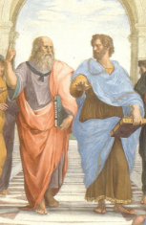
Notes, etc.…

Slide 22
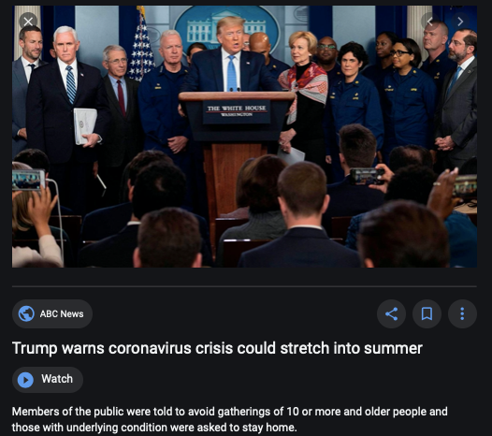
Coronavirus!

Slide 23
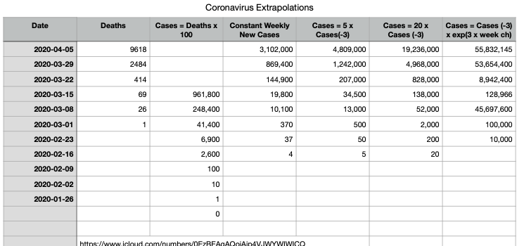
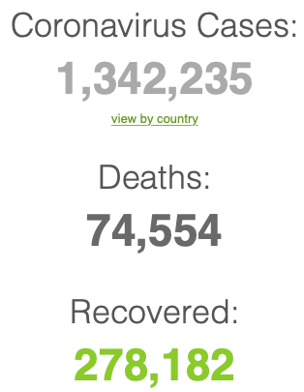
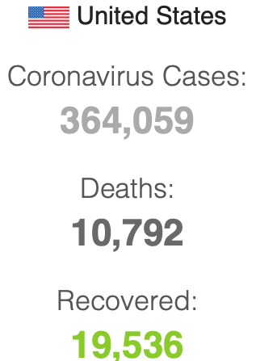

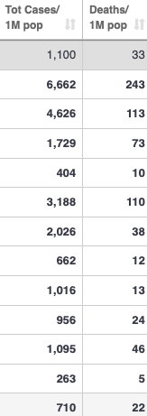
Coronavirus
Where we think we are, as of Th Apr 09:
We really do not know
No random samples…
If we extrapolate out the past week straight-line log:
We will have 440,000 deaths in three weeks
But it is unlikely to be that bad
Best thing I have read comes from Jim Stock <https://drive.google.com/file/d/12MV466ZZy5xHir4xdPhoTrL1oO8CbZU-/view>:
The basic SIR epidemiological model of contagion
The effect of social distancing and business shutdowns on epidemic dynamics enters the model through a single parameter: the case transmission rate β
Re-express the model in terms of β and the asymptomatic (or not very symptomatic) hence non-tested rate—the fraction of the infected who are not tested
The COVID-19 non-testing rate is unidentified in our model
Estimates in the epidemiological literature range from 0.18 to 0.86.
The asymptomatic rate could be estimated accurately and quickly by testing a random sample
The optimal policy response and its economic consequences hinge critically on the asymptomatic rate

Slide 24
Coronavirus II
We do not really know where we are, as of Mo Apr 6:
Best thing I have read comes from Jim Stock <https://drive.google.com/file/d/12MV466ZZy5xHir4xdPhoTrL1oO8CbZU-/view>:
The basic SIR epidemiological model of contagion
The effect of social distancing and business shutdowns on epidemic dynamics enters the model through a single parameter: the case transmission rate β
Re-express the model in terms of β and the asymptomatic (or not very symptomatic) hence non-tested rate—the fraction of the infected who are not tested
The COVID-19 non-testing rate is unidentified in our model
Estimates in the epidemiological literature range from 0.18 to 0.86.
The asymptomatic rate could be estimated accurately and quickly by testing a random sample
The optimal policy response and its economic consequences hinge critically on the asymptomatic rate

Slide 28

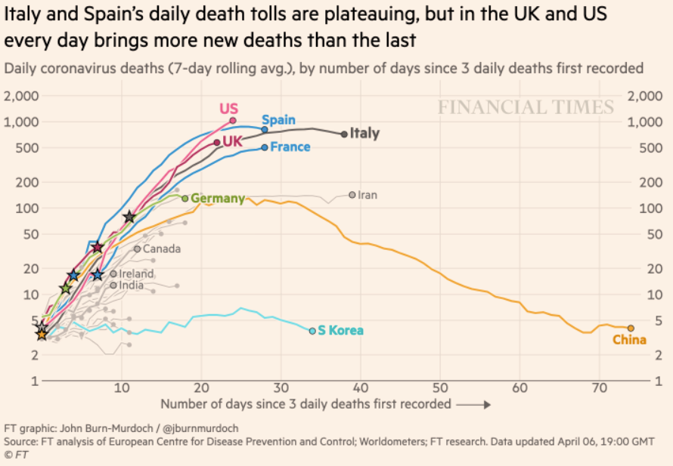
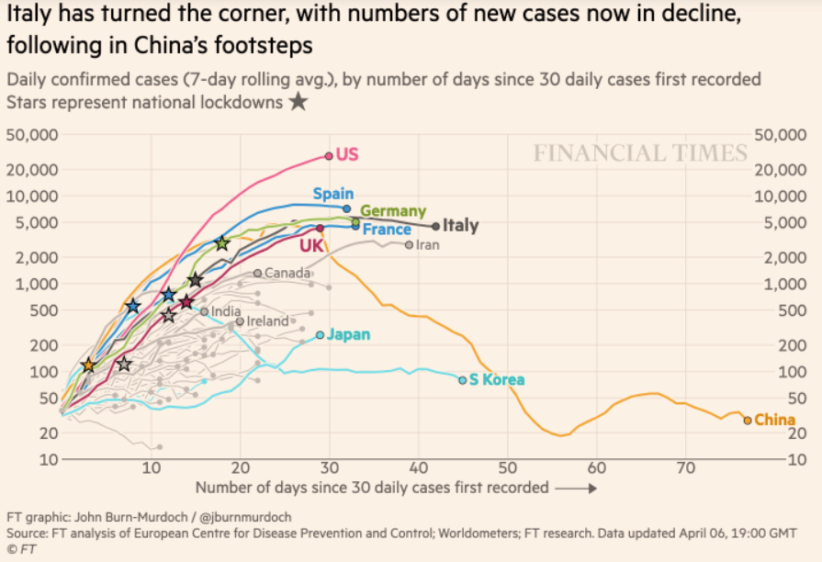
Financial Times Graphs Blown Up…

Slide 32

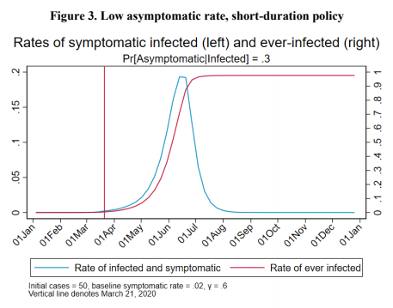
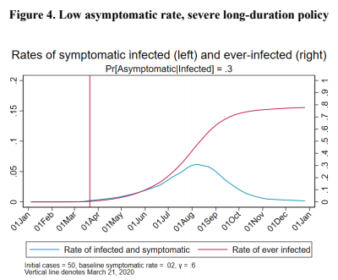
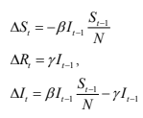
James Stock (2020)
Standard SIR model:<https://drive.google.com/file/d/12MV466ZZy5xHir4xdPhoTrL1oO8CbZU-/view>:
Susceptible, Infected, Recovered (& immune), transmission rate β, recovery rate γ, reproduction number R0, asymptomatic hence non-tested rate π0
Calibration: half-life of infection one week: γ = 0.5, s0 = 0.02, 50 cases on Jan 24
For March 21, 2020, the positive test rate in the United States is approximately 10%…
<https://drive.google.com/file/d/12MV466ZZy5xHir4xdPhoTrL1oO8CbZU-/view>

Slide 37
Bringing the Economy Back Up from Anæsthesia
Major issues:
Certificates of immunity:
Which requires test, test, test:
And not just disease virus tests
Presence-of-antibodies tests
How quickly can we match the immune with public-contact jobs?
What jobs can be done with minimal infection risk?
What minimal-infection substitutes can we find for previous jobs?
How quickly can restrictions be relaxed without the virus coming roaring back?
How do we avoid having the market give a “shutdown” signal to enterprises we in fact want restarted?
Which is pretty much all of them
How much of the potential caseload do we want to push out beyond the vaccine-arrival date?
ALL THESE QUESTIONS ARE ANSWERABLE IF WE LEARN THE ASYMPTOMATIC HENCE NON-TESTED RATE!!

Slide 38
Keeping the Economy from Crashing During the Lockdown
Nick Rowe: We have a 50% output cut in 100% of the sectors:
A temporary 100% output cut in 50% of the sectors (what the Coronavirus does) is very different from a 50% output cut in 100% of the sectors
Nick’s thought experiment:
In three months we are going to invent unobtanium:
Substantial intertemporal substitutibility
Plus lower cross-good contemporaneous substitutitbility
Hence high desired savings rate now
Flex-price market thus produces a nominal rate at the zero lower bound and a high inflation rate over the next three to six months
Plus liquidity-constrained workers in affected sectors see their demand go to zero immediately
Can we get there? Should we get there? What should we do instead?
We need a good RBC economist: are there any?…
<https://worthwhile.typepad.com/worthwhile_canadian_initi/2020/03/relative-supply-shocks-unobtainium-walras-law-and-the-coronavirus.html>

Slide 39
Keeping the Economy from Crashing During the Lockdown II
Nick Rowe:
<https://worthwhile.typepad.com/worthwhile_canadian_initi/2020/03/relative-supply-shocks-unobtainium-walras-law-and-the-coronavirus.html>
Plus: to extend the thought experiment:
We just lost the ability to make “unobtainium”
So we should be substituting leisure for work, and moving workers into relatively unproductive labor, making the commodities we can still produce right now
How should relative prices move as a result? How should we make them move?
Plus: distributional issues
Plus: bankruptcy and credit chain issues

Slide 40

MOAR Coronavirus!
Death for Geezers!
Mortality for the Youngs very low…
It’s the flu for them—for you…
And an extra doubling—or is it 5%?—mortality for the asthmatic
And an extra doubling—or is it 5%?—mortality for the overweight

Slide 41
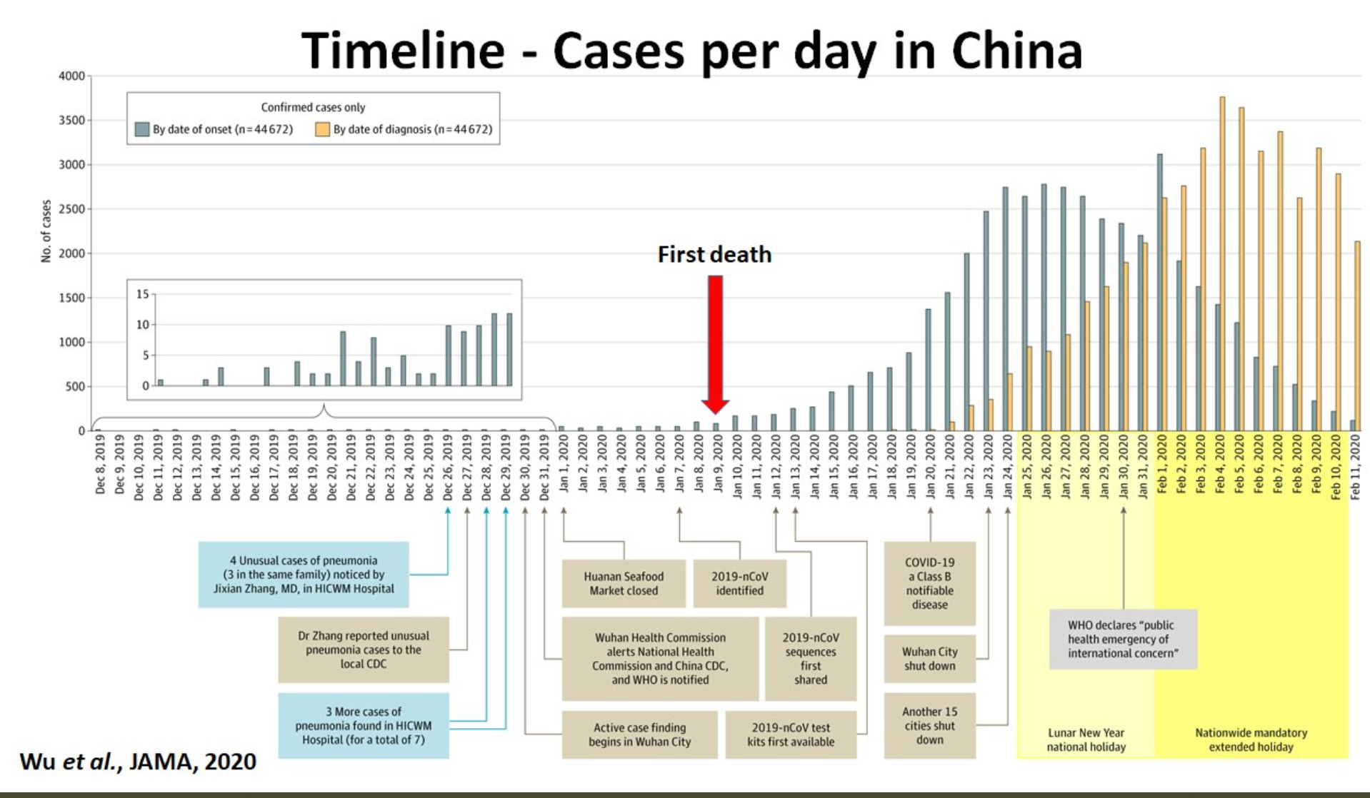
What We Think Happened in Wuhan
China beat it quickly & relatively easily!
We think
Shut down Wuhan when 200 cases per day
That seems to have been a good decision

Slide 42

The Goal
When Is It Appropriate to Move on This?
Immediate social distancing…
Self-isolate if you have a cough and a fever…
Hope that warmer temperatures will do to this what they did to SARS…
Otherwise, when do you want to start spreading out transmission. It seems that early is as good as later, so do it early…
I have no good intuition on why you want to move early
Plus your moving early will be wasted if you get reinfected
Plus the sparks you throw off making others’ lives more difficult

Slide 43
References
Financial Times (2020): Coronavirus Tracked: The Latest Figures as the Pandemic Spreads <https://www.ft.com/coronavirus-latest>
Nick Rowe (2020): Relative Supply Shocks, Unobtainium, Walras' Law, and the Coronavirus <https://worthwhile.typepad.com/worthwhile_canadian_initi/2020/03/relative-supply-shocks-unobtainium-walras-law-and-the-coronavirus.html>
Jim Stock (2020): Coronavirus Data Gaps and the Policy Response <https://drive.google.com/file/d/12MV466ZZy5xHir4xdPhoTrL1oO8CbZU-/view>

Slide 44
MOAR Coronavirus!
What I am watching:
Max Roser & Hannah Ritchie: Coronavirus Disease (COVID-19) <https://ourworldindata.org/coronavirus>…
Worldometer: Coronavirus Update (Live) <https://www.worldometers.info/coronavirus/>: ‘125,599 Cases and 4,605 Deaths from COVID-19 Virus Outbreak…
FT Coronavirus Tracker <https://www.ft.com/content/a26fbf7e-48f8-11ea-aeb3-955839e06441>
Josh Marshall’s COVID Twitter List <https://twitter.com/i/lists/1233998285779632128>
NEJM Group: Updates on the Covid-19 Pandemic <http://m.n.nejm.org/nl/jsp/m.jsp?c=%40kxNtXckRDOq8oG0jJvAXsIzN4mPECIPhltxoTSdTU9k%3D&cid=DM89089_NEJM_COVID-19_Newsletter&bid=173498255>: 'From the New England Journal of Medicine, NEJM Journal Watch, NEJM Catalyst, and other trusted sources...

Slide 45
Catch Our Breath…
Ask a couple of questions?
Make a couple of comments?
Any more readings to recommend?
<https://www.icloud.com/keynote/0YKEi7HeOrVGvKYtt9FEqH7nA>
<https://www.bradford-delong.com/2020/04/coronavirus.html>
github:<https://github.com/braddelong/public-files/blob/master/coronavirus.pptx>
https://github.com/braddelong/public-files/blob/master/coronavirus.pdf>
html File: <https://www.bradford-delong.com/2020/04/coronavirus.html>
Edit This File: <https://www.typepad.com/site/blogs/6a00e551f08003883400e551f080068834/post/6a00e551f080038834025d9b3bd66a200c/edit>
<https://delong.typepad.com/files/2020-04-01-coronavirus.pdf>

Slide 46
Coronavirus! (March 16)
With 31 deaths in the U.S. as of March 11, a 1% death rate, and up to 4 weeks between infection and death, that means that as of Feb 12 there were 3100 coronavirus cases in the United States.
With 87 deaths in the U.S. as of Mar 16, a 1% death rate, and up to 4 weeks between infection and death, that means that as of Feb 17 there were 8700 coronavirus cases in the United States
If it is doubling every seven days, then now about 150,000 people have and in the next week about 150,000 more people in the U.S. will catch coronavirus—which means 1/2200, currently 3500 of the 7.6 million inhabitants of San Francisco Bay. Touch a hard surface that any of those 3500 has touched in the last 48 hours, and the virus has a chance to jump to you…
These numbers could be five times too big. These numbers are probably not five times too small unless the thing is a lot less deadly, and there are a lot of asymptomatic cases…
What is wrong with this analysis?

Slide 47

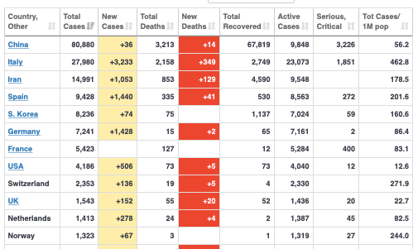
MOAR Coronavirus!
As of March 21: Things are not moving in the right direction:
What is the R0?
How can the R0 be changed?
How will the R0 change?
What is the asymptote share of the population?
What is the mortality rate?

Slide 48


MOAR Coronavirus!
As of March 10: Things are not moving in the right direction:
What is the R0?
How can the R0 be changed?
How will the R0 change?
What is the asymptote share of the population?
What is the mortality rate?

Slide 49
Notes

